Slide 1
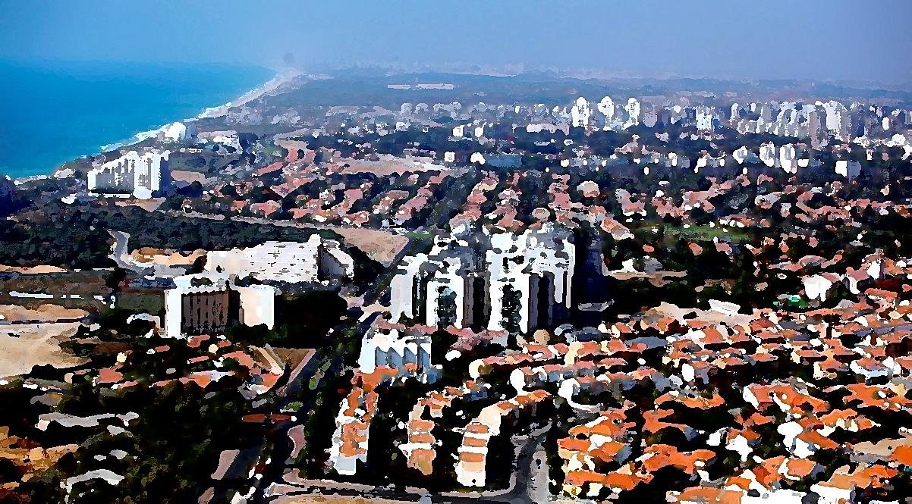
Raising City Resilience
Urban Resilience Analysis System –
Decision Support System
The City of Ashkelon

Slide 2
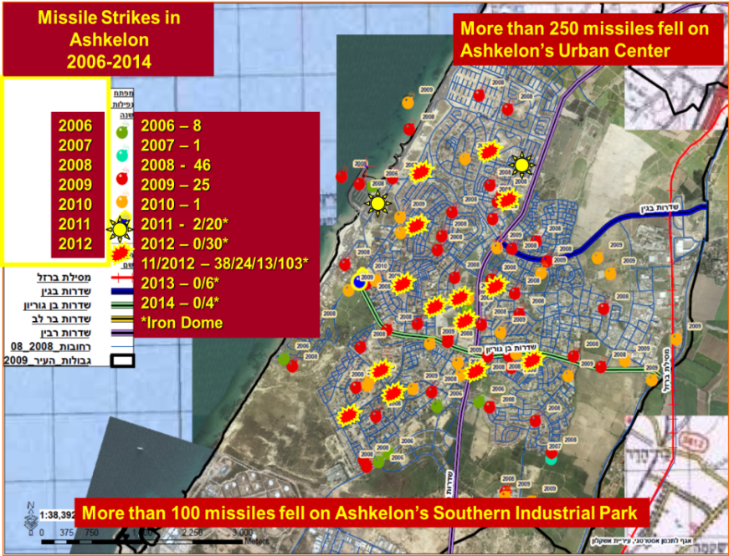
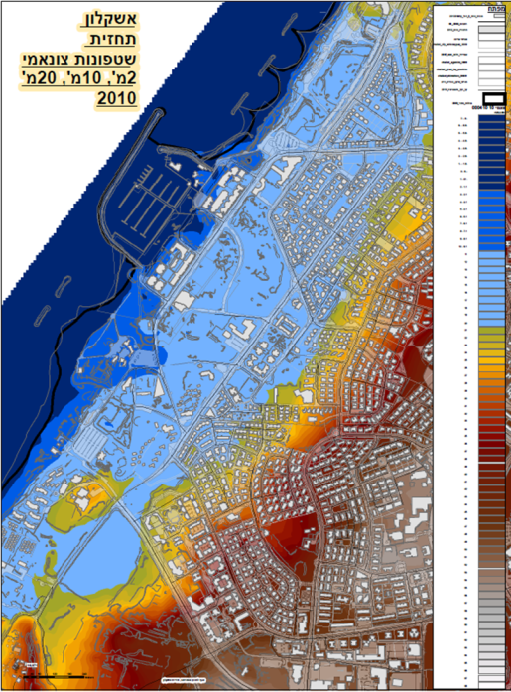
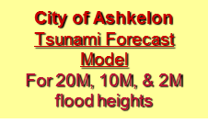
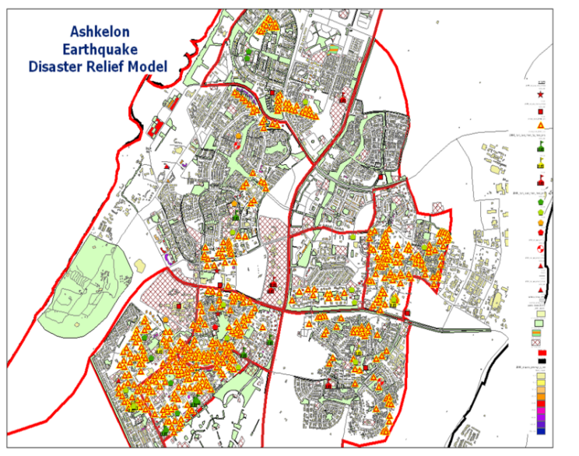
Raising City Resilience
Understanding the distribution and magnitude of critical resilience challenges (shocks) and Chronic stresses is crucial for building resilience in Ashkelon.
The City’s Major Chronic Stresses are:
Rapid New Population Growth: 140% in 26 years
Aging Population: 60+ more than19%
Chronic Unemployment: 8.4% vs 7.0%
Geographic based Economic Inequity: North South
Crime and Violence: moderate
Missile strikes
Tsunamis
Earthquakes

Slide 3
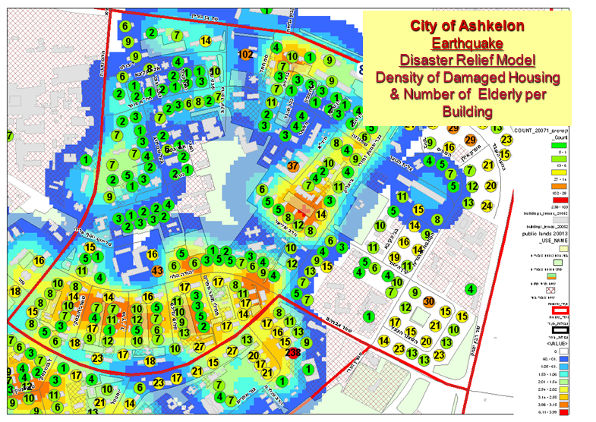
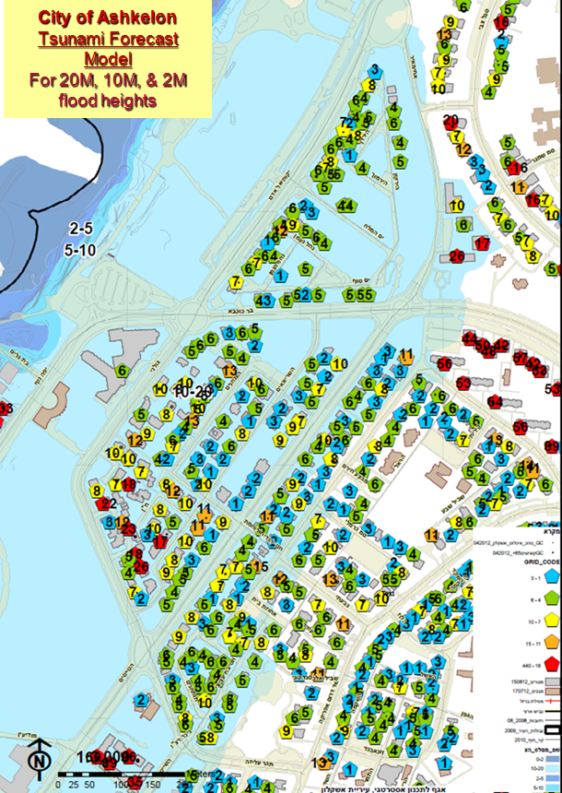
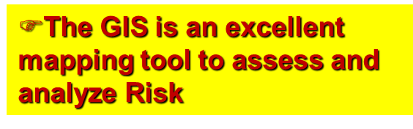
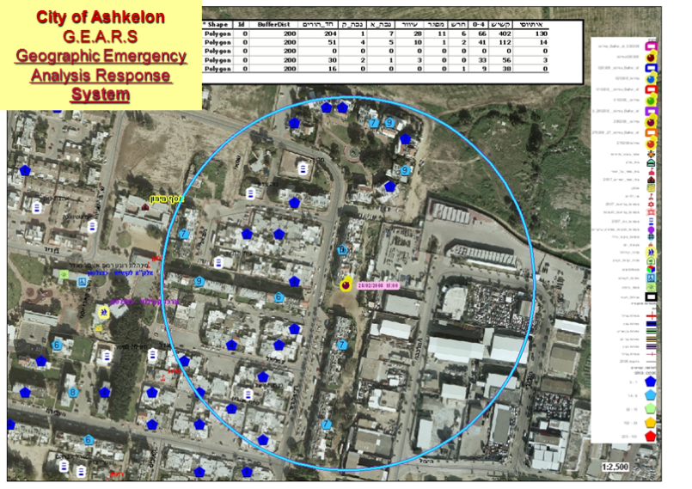
Understanding Risk for Homeland Security and Emergency Preparedness
Development of some innovative GIS tools to asses, analyze, and map the spatial distribution of Risk..
Develop Clear and Effective Evaluations of Options, Alternatives and Scenarios as well as Presenting the Consequences and Impacts for Understanding Risk

Slide 4
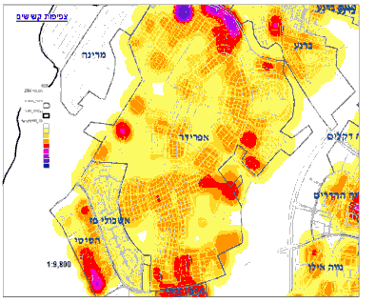
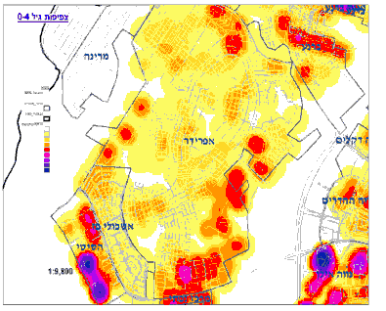
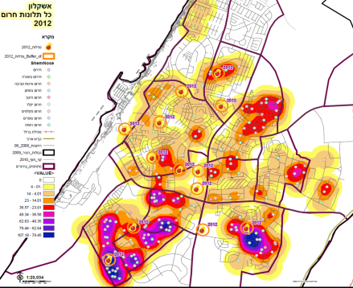
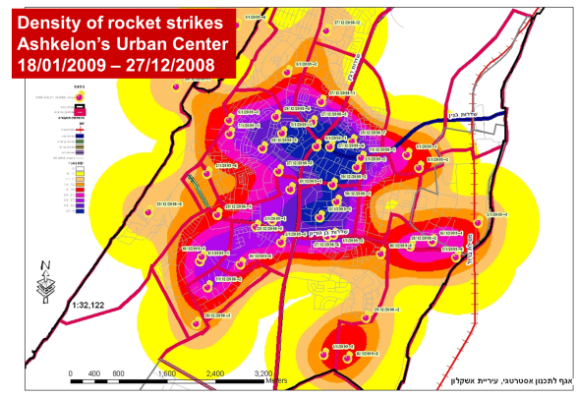
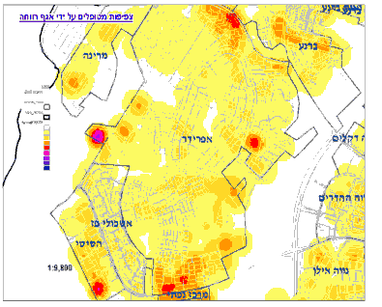
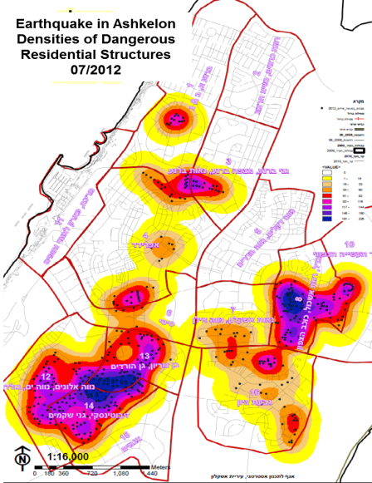
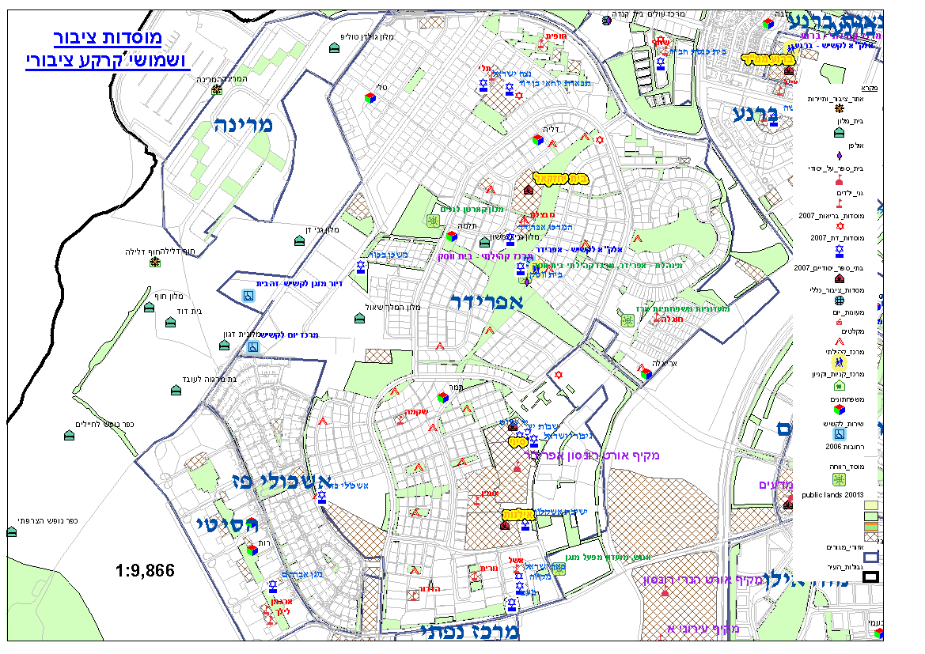
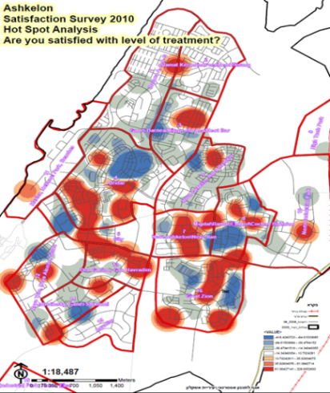
Development of an Urban Resilience Analysis System to identify local zones with chronic resilience problems (Urban Stress Zones) Decision Support System
Demographic Information
Terrorism Information
Density of missile Attacks
Density of Hot line Requests
Density of
Elderly 65+
Density of
Young 0-4
Crime & Violence Information
Service Request Information
Health Status Information
Emergency Service
Request Information
Mental Health Information
Density of
Social Services
Recipients
Social Services Information
Urban Resilience Analysis System
to define Urban Stress Zones
  With Large Sensitive Populations
  With High Risk of Potential Physical Stress and Damage
  With Large Numbers of Hot Line Requests
  With Low Resilience Survey Levels
  Create a Resilience Neighborhood Profile Assessment using Statistical Analysis, GIS mapping and Segmentation Analysis
Natural Disaster Information
Density of Earthquake Damages
Public Institutions,
Infrastructure, &
Land Use
Education Information
Socio-Economic Information
Employment Information
Resilience Survey Information
Tsunami Extent
Environmental Quality Information
Our Object is to understand the Distribution Patterns of Risk and to build effective Resilience. These Analyses help define dynamic zones with varying intensities of resilience.

Slide 5
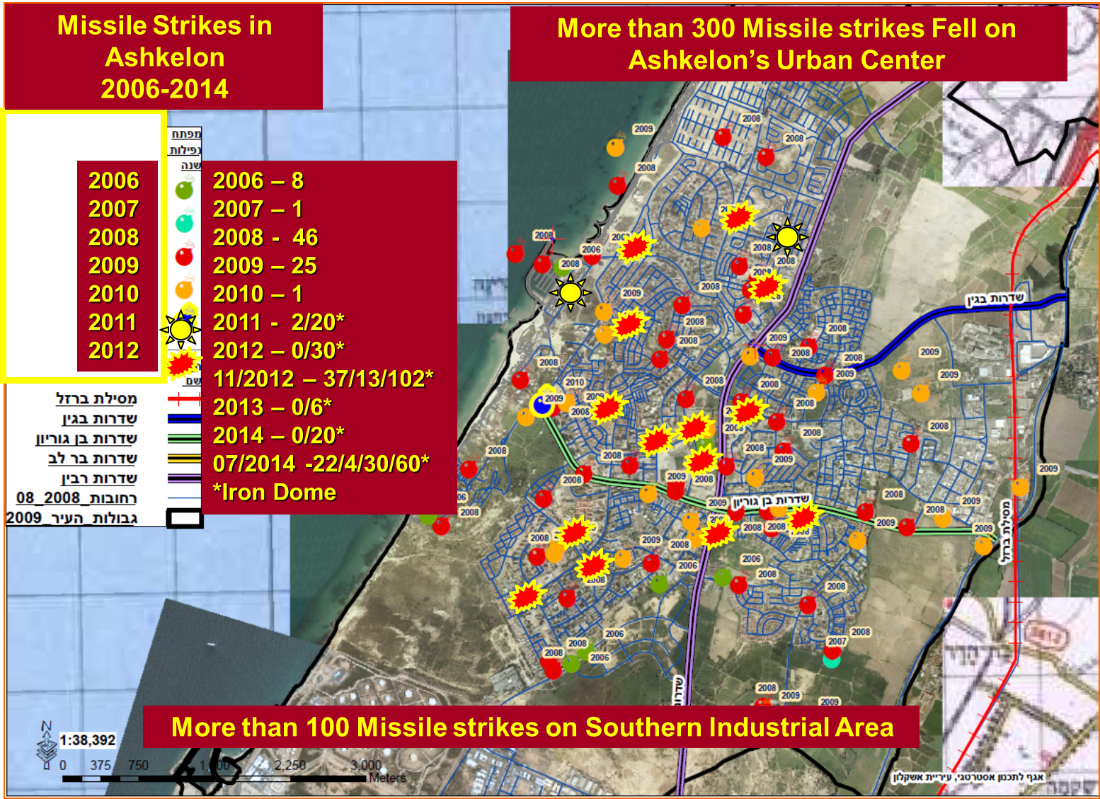
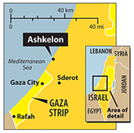
Resilience Case Study:
Ashkelon Under Fire 2006-2014
More than 600 Missile strikes fell on
Ashkelon’s Urban Center
The City’s Major Chronic Stresses are:
Rapid New Population Growth: 140% in 26 years
Aging Population: 60+ more than19%
Chronic Unemployment: 8.4% vs 7.0%
Geographic based Economic Inequity: North South
Crime and Violence: moderate
Major Resilience Challenge (Shock) :
Since 2006 continual bombardment 800 rockets
From July 7, 2014 - August 26, 2014 the city was shelled by at least 277 rockets.
2006- 8
2007- 1
2008- 27
12/2008-01/2009 - 47/0/26
2009 – 2
2010 – 1
2011 – 20/2*
2012 – 30/0*
11/2012 – 103/66/13*
2013 – 6/0*
2014 -20/0*
07/2014-08/2014 – 277/160/10*
*Iron Dome
07/2014 – 8/138/233*
More than 200 Missile strikes fell on Southern Industrial Area

Slide 6
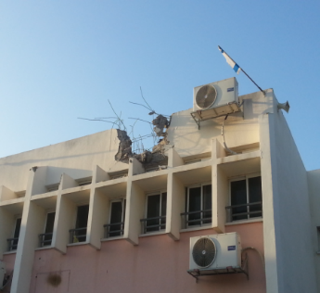
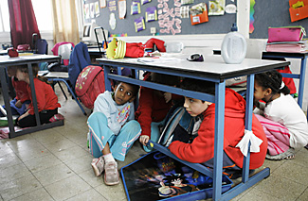
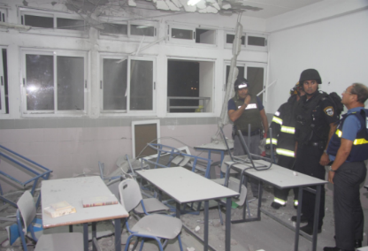
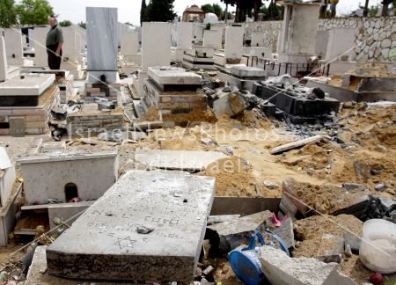
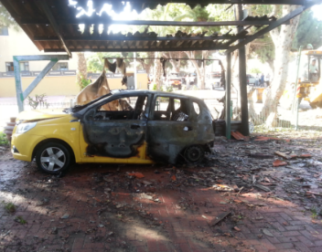
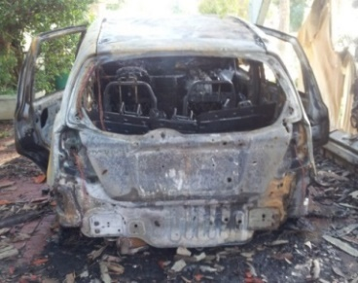
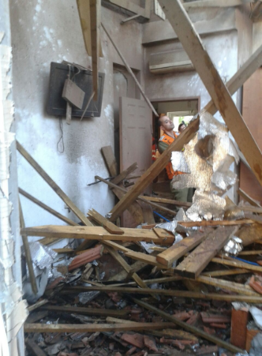
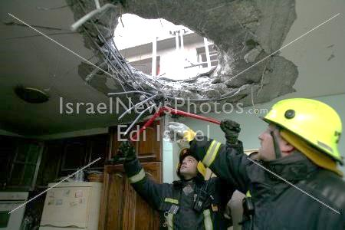
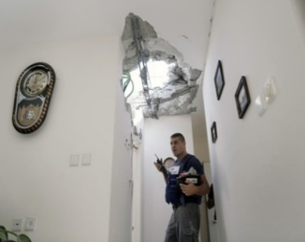
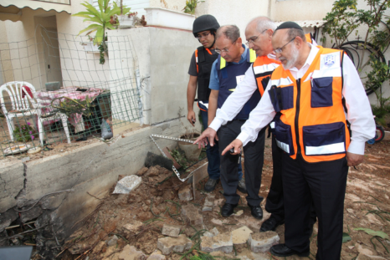
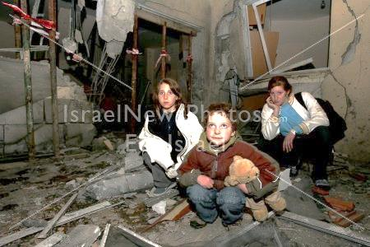
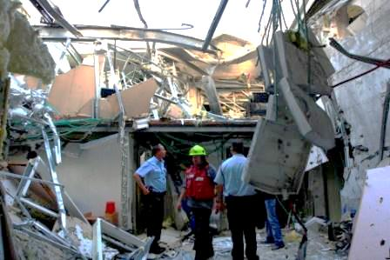
Schools
Resilience Challenge Consequences
Moderate casualties- 85% of the population has in home/building shelter s
Sustained psychological stresses, trauma, and anxieties that cannot always be immediately detected. Suffered by a large segment of our residents
Citizens most susceptible : The elderly, the very young, the poor, and the mentally and physically challenged.
Economic consequences of sustained rocket strikes on Ashkelon’s economy have been severe and have been especially devastating for small businesses
Cemeteries
5
Vehicles
Homes
Shopping Malls
Shock, Trauma, Anxiety

Slide 7
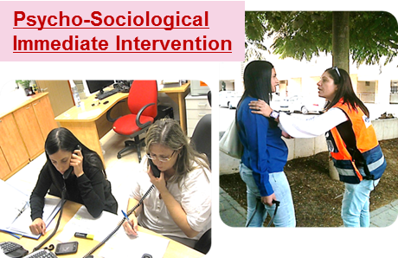
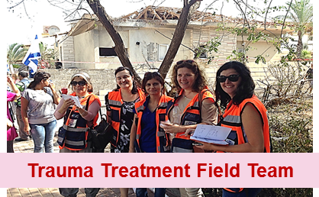
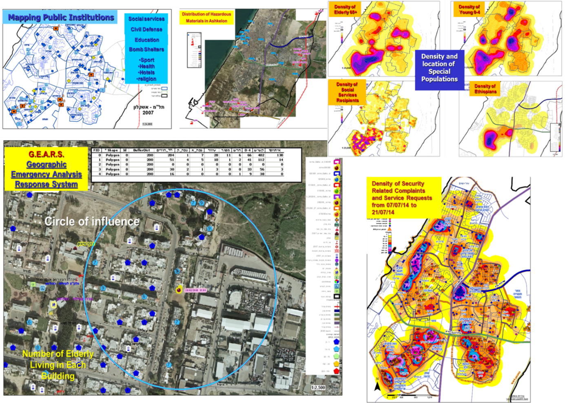
Ashkelon has learned to adapt and evolve a system to mitigate and reduce the impacts of our resilience challenge
Psycho-Sociological Treatment System - Ensures Public Health Services: Reflective, Flexible, Resourceful, Inclusive-
  An augmented social services and trauma treatment scheme to help to reduce the shock levels of the residents.
  The school resilience system is teacher-professional based
  Classroom psychological “first aid” system - coping strategies and resilience building to reduce continuous stress and psychological trauma for children.
GEARS & GDSS - Ensure continuity of critical Services & Fosters long-term & integrated planning: Reflective, Robust, Redundant, Flexible, Integrated –
  Geographic Emergency Analysis Response System (GEARS), analyses system to instantly map information during disaster events.
  Onsite response teams created within minutes of the event.
  Geographic analysis of emergency calls by type and location.
  GIS analyses to formulate short and long range solutions during recovery and rehabilitation
  GIS Decision Support System (GDSS), helps to develop a follow-up system for integrated decision making and resource allocations for the resolution of future emergency management situations.

Slide 8
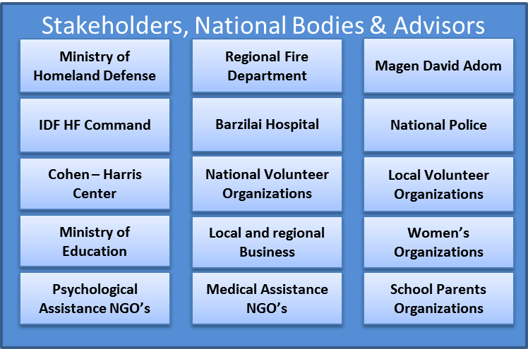
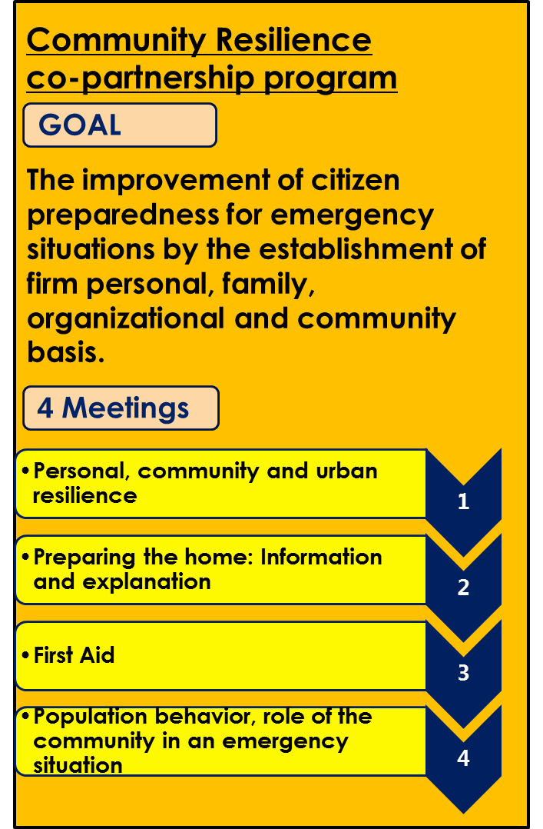
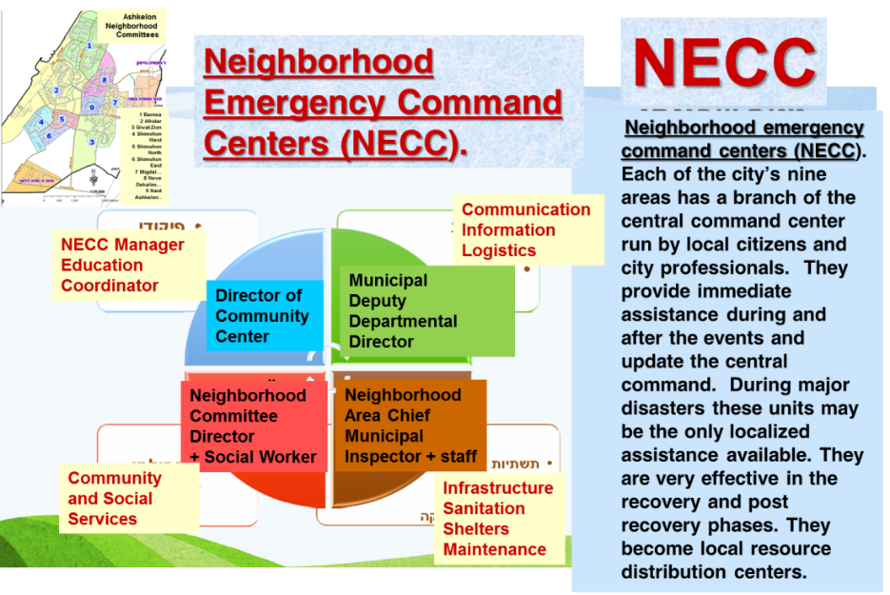
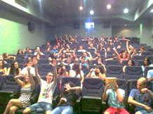
ISO 24001 International Standard - Security Management System for Resilience
Even before 2006, Ashkelon has learned to adapt and evolve a system to mitigate and reduce the impacts of our resilience challenge
ISO 24001 Urban Resilience Plan - Promotes leadership & effective management and Empowers a broad range of Stakeholders: Reflective, Flexible, Inclusive, Integrated –
  ISO 24001 Urban Resilience plan, all phases of emergency management planning, response and recovery
  Collaboration of multiple stakeholders.
  Stakeholders can be divided into five main groups: first responders, early recovery, late recovery, rehabilitation & renewal, and post recovery & assessment.
  Individual, local, regional and national stakeholders provide the expertise, assistance and breadth of knowledge to successfully engage the Resilience Challenge.
NECCs Promotes cohesive and engaged communities & Empowers a Broad range of Stakeholders: Reflective, Robust, Flexible, Resourceful, Inclusive, Integrated, and Redundant -
  Neighborhood Emergency Command Centers are run by local citizens and city professionals in each of 9 neighborhoods
  Provide immediate assistance during and after the events and update the central command.
  Redundancy insures continuation of effective management
  Enlist large numbers of community volunteers that in time of emergencies help us to provide special social activities to our children and elderly.
The City of Ashkelon is the first city in the world to be awarded this ISO (International Organization for Standardization) standard in 2012 by the Israel Standards Institute. This program encompasses terror and natural disaster management planning, response and recovery

Slide 9
Raising City Resilience
GEARS
Geographic
Emergency
Analysis
Response
System
Psycho-
Sociological
Treatment
System
ISO 24001
Urban Resilience
Plan
NECC
Neighborhood
Emergency
Command
Center
GDSS
GIS Decision Support System
Benefits of Resilience:
Our plan is an integrated model of policies, operations, actions, roles, structure, and physical and human resources.
Minimizes shocks and stresses,
Improvement Driven and adaptable.
This system is flexible for crisis management and resilience building
Aids in learning from our errors, making adjustments, and exploring alternative solutions to be better prepared for tomorrow.
Fosters resident confidence and builds resident resilience
Increases city’s ability to withstand the crises
Suitable for sharing with other cities

