Slide 1
SIAAP
Resources recovery policy
Notes:
In the context of a growing population around the World, with Climate change risks and resources scarcity, each one has contribute to recover materials and to a carbon neutral society. This one of the duties of sewage treatment as well as solid waste utilities.
SIAAP is now strongly committed in these challenges of resources recovery and green energy production
My presentation aims at show the works that are currently in progress at SIAAP

Slide 2
SUMMARY
Biogas: resources recovery
Sludge: resources recovery
    - Foccus on agricultural valorization
- Foccus on energy recovery
Biogas: resources recovery prospects
Sludge: resources recovery prospects

Slide 3


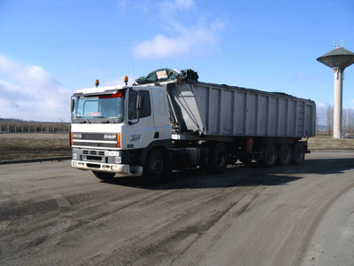
Waste water as a resource
1 m³ Water is:
Biogas:
0.7 kWh
245 g TSS
180 g BOD₅
430 g COD
50 g N
5 g P
1.1 kWh
Sludge:
0.4 kWh
Energy
For the treatment of
1 m³ = 1.25 kWh
Notes:
Sewage treatment spend lots of energy but it’s also a resource that we have to use if we don’t want to spend too much money

Slide 4
BIOGAS
Resources recovery

Slide 5
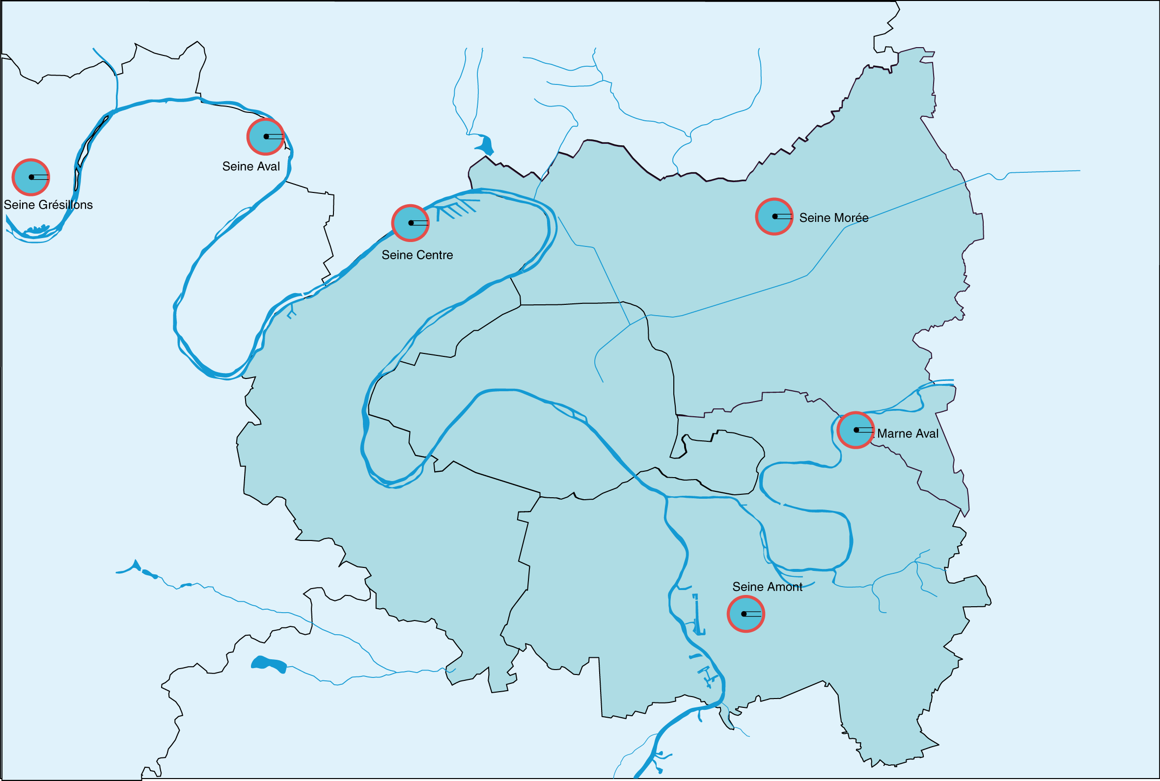
Sludge production before treatment
Total SIAAP 2017 :
133 700 tDM
Sludge b.t : 231 700 tDM
16 200 tDM
1 100 tDM
19 000 tDM
6 600 tDM
55 100 tDM
Source SIAAP
Notes:
Chiffres arrondis
Pour mémoire : 233 200 tMS extraites de la file eau

Slide 6




Biogas production
Total SIAAP 2017 :
133 700 tDM
Sludge b.t : 231 700 tDM
60 MNm³
Biogas prod. : 91 MNm³
16 200 tDM
1 100 tDM
19 000 tDM
14 MNm³
6 600 tDM
Sludge treatment
Digestion
55 100 tDM
16MNm³
Source SIAAP
Notes:
Sludge was just considered for a long time as waste : the main objective of sludge treatment was to dry, to reduce the volume evacuated
but, it can also produce energy
in SIAAP, 3 Wastewater Treatment Plant includes digestion in their treatment, first of all to reduce the sludge volume. But, it produce also energy which can be used for the plant.
Today, we consume almost all of our biogas production to power our energy processes

Slide 7
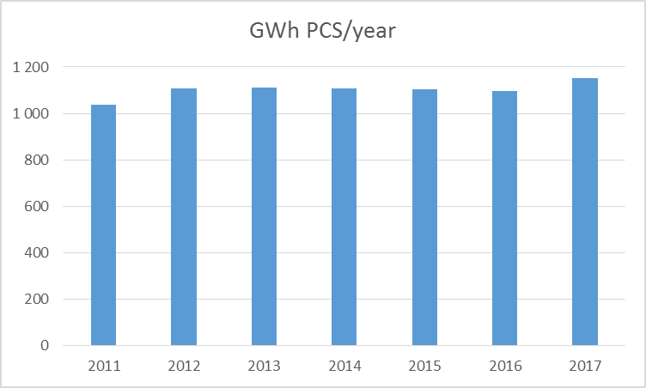
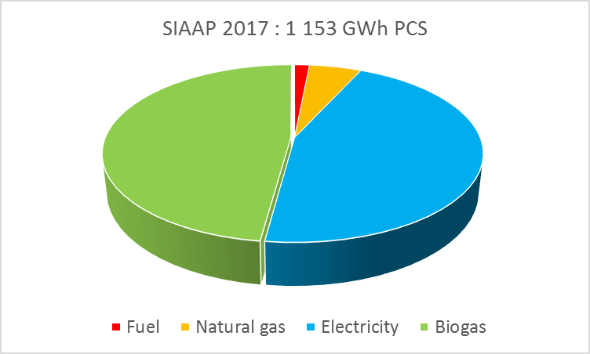
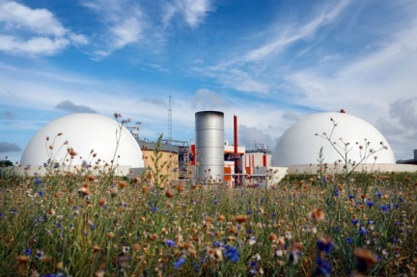
SIAAP energy balance
Biogas: 552 GWh → 48% needs covered
Electricity: 522 GWh
  Electric selfproduction: 36 GWh (7%)
  Sewage network (pumping): 45 GWh (8%)
Fuel: 17 GWh
Natural gas: 61 GWh
→ Average consumption: 1.32 kWh/m³ or 6.24 kWh/kg BOD5 removed
WWTP and sewage network energy balance
Notes:
520 (five hundred and twenty) GWh PCS consumed : TAG (gas turbines), digestion, sludge conditioning
Nowadays, the production of biogas or sludge incineration is not important enough to be self-sufficient. That’s why we continue to consider sludge as a ressource under exploited, and why we study another ways to increase energy production with sludge

Slide 8
SLUDGE
Resources recovery

Slide 9
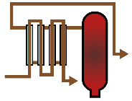







Sludge production after treatment
Total SIAAP 2017 :
54 100 tDM
Sludge b.t : 231 700 tDM
Biogas prod. : 91 MNm³
Sludge a.t. : 122 600 tDM
1 400 tDM
18 100 tDM
12 300 tDM
6 200 tDM
Sludge treatment
Digestion
Drying
Thermal conditioning
Incineration
30 500 tDM
Source SIAAP
Notes:
From one wastewater treatment plant to another, we have different modes of treatment.
These different treatments will produce sludge of different characteristics

Slide 10
Seine aval sludge spreading
The different types of sludge:
    Dried sludge: dryness of 85 to 95%
      Ressources recovery: Cement plant - Composting
    Sludge dehydrated by filter press: dryness of +/- 50%
      Ressources recovery: Land application - Composting
    Centrifuged sludge: 23% dryness
      Ressources recovery: Composting
Notes:
Depending on the characteristics of the sludge, the recovery routes will be different

Slide 11
Sludge treatment SAV
1 THICKENING
Biogas
2 DIGESTION
3 THICKENING
4 THERMAL CONDITIONING
5 DEWATERING
Dried sludge
Back to the inlet of the WWTP
6 TREATMENT OF EFFLUENT FROM SLUDGE TREATMENT

Slide 12
Sludge treatment SEC
PHYSICO-CHEMICAL TREATMENT
BIOLOGICAL FILTERS
PRIMARY SLUDGE
1 THICKENING
BIOLOGICAL SLUDGE
2 DEWATERING
3 INCINERATION
CHIMNEY
FURNACE
HEAT RECOVERY
ELECTROSTATIC FILTER
WET SCRUBBING
BAG FILTER
CATALYTIC TREATMENT

Slide 13
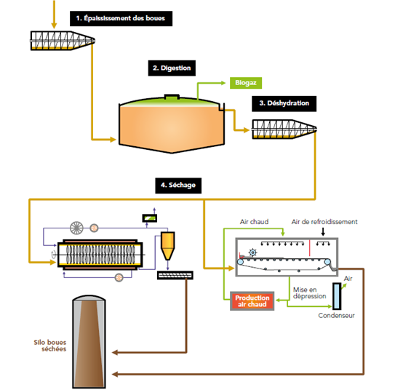
Sludge treatment SEG
1 THICKENING
2 DIGESTION
3 DEWATERING
4 DRYING

Slide 14
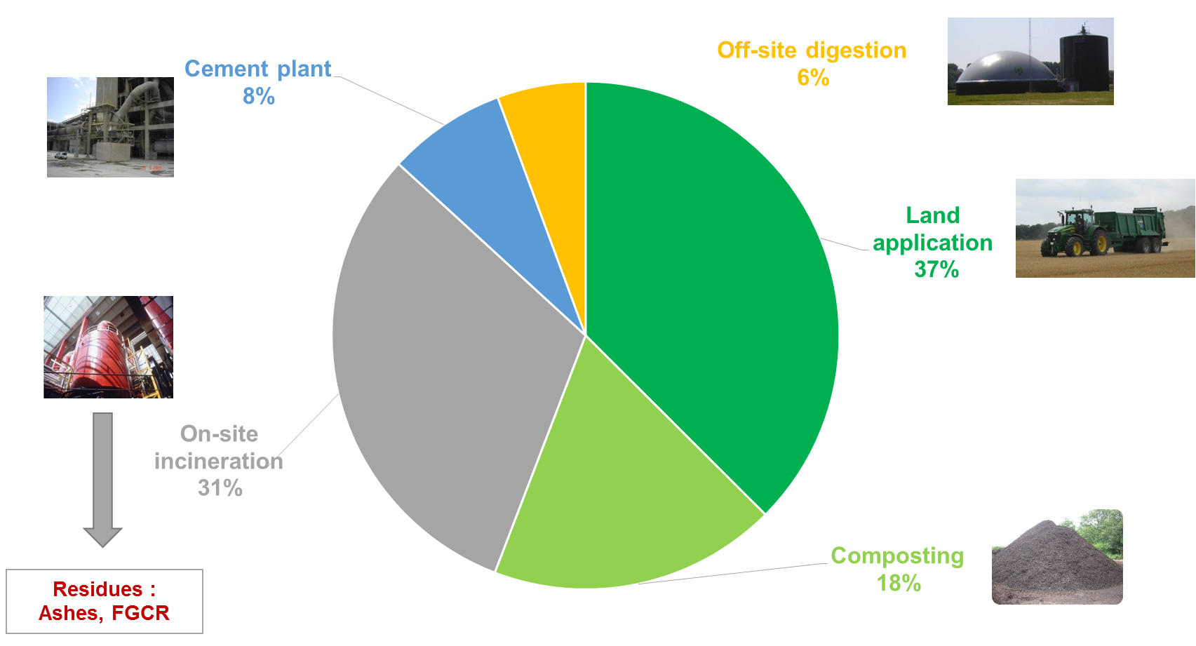
Sludge valorization paths (2017)
61% recycled to land
Notes:
Ashes : 8 035 t
FGCR : 770 t
Here is the distribution of the different sectors of ressources recovery of our sludge. To date, agricultural valorization represents the largest share with more than 60% of valorization in

Slide 15
SLUDGE
Foccus on agricultural valorization

Slide 16
Characteristics of Seine Aval’s sludge
On average 50.54% dry matter
➔ Solid and stabilized sludge (heap storage possible)
Result of a heat treatment pushed
➔ Hygienised sludge
Rich in Phosphorus and Sulfur
➔ Fertilizer interest for crops
Rich in Calcium and Organic Matter
➔ Amending interest for soils
Other parameters | Weighted average
Dry Matter | 51,7
C/N | 12,69
pH | 8,39
Elements | Contents (en kg/t MB) | Availability factor | Quantities brought (en kg/ha) |  | Quantities available the 1st year (en kg/ha)
 |  |  | à 6 t/ha | à 8 t/ha | à 6 t/ha | à 8 t/ha
Total Nitrogen (TKN) % organic matter % Ammonia | 10,0 | - 7 % 100 % | 60,0 | 80,0 | 14 | 19
Magnesium (MgO) | 8,2 | 48 % | 49,2 | 65,6 | 3 | 5
Potassium (K₂O) | 1,8 | 10 % | 10,8 | 14,4 | 11 | 14
Phosphore (P₂O₅) Lots standards | 5,2 | 75 % | 31,2 | 41,6 | 15 | 20
Lots > 55 kg/tMB (6t/ha)* | 0,7 | 75 % | 4,2 | 5,6 | 1 | 1
Soufre (SO₃) | 48,3 | 44 % | 289,8 | 386,4 | 217 | 290
* For lots with a P2O5 content exceeding 55 kg / tMB, the application rate is reduced to around 6 t / ha in order to limit phosphorus inputs.
Availability factor | Contents (en kg/t) | Stability Index of Organic Matter | Quantities brought (en kg/ha) |  |  | Quantity of stable organic matter generated(en kg/ha)
 |  |  | à 6 t/ha |  | à 8 t/ha | à 6 t/ha | à 8 t/ha
Organic matter | 206,1 | 81 % | 1 236,6 | 1 648,8 |  | 1 002 kg | 1 336 kg
Calcium (CaO) | 61,8 | - | 370,8 | 494,4 |  | - | -
Notes:
Only sludge from the Wastewater treatment plan of Seine aval can be spread in agriculture. They are the only ones to be the subject of a plan of spreading.
Cooking at 195 ° C (one hundred and ninety five) and 20 bar pressure for 45 minutes
In order to be spread under these conditions (storage at the end of the fields, continuous evacuation ...), the sludge must meet certain characteristics:

Slide 17
Characteristics of Seine Aval’s sludge
Metallic Trace Element content of Seine aval sludge
The averages expressed are weighted by the tonnage of each lot.
Elements | Units | Spreaded sludge in 2017 |  |  | Produced sludge in 2017 |  |  | Regulatory limit values
Number of analyzes |  | 53 |  |  | 52
Number of lots |  | 51 |  |  | 50
 |  | Min. | Max. | Moy. | Min. | Max. | Moy.
Cd | mg/kg de MS | 1,6 | 5,5 | 3,0 | 1,3 | 4,5 | 2,5 | 10
Cr | mg/kg de MS | 45,0 | 79,5 | 61,1 | 45,0 | 67,0 | 58,9 | 1000
Cu | mg/kg de MS | 535,7 | 833,1 | 706,3 | 535,7 | 782,4 | 663,3 | 1000
Hg | mg/kg de MS | 1,4 | 2,9 | 1,9 | 1,4 | 3,0 | 1,8 | 10
Ni | mg/kg de MS | 20,9 | 34,6 | 26,8 | 20 9 | 45,3 | 29,4 | 200
Pb | mg/kg de MS | 91,0 | 195,0 | 127,7 | 91,0 | 168,0 | 132,3 | 800
Zn | mg/kg de MS | 1 443,0 | 2 059,3 | 1 724,8 | 1 443,0 | 2 059,3 | 1657,2 | 3 000
Cr+Cu+Ni+Zn | mg/kg de MS | 2051,0 | 2921,0 | 2519,0 | 2 051,0 | 2 843,0 | 2408,8 | 4 000
Content in organic trace compounds sludge of Seine aval
The averages expressed are weighted by the tonnage of each lot.
Elements | Units | Spreaded sludge in 2017 |  |  | Produced sludge in 2017 |  |  | Regulatory limit values
Number of analyzes |  | 53 |  |  | 52
Number of lots |  | 51 |  |  | 50
 |  | Min. | Max. | Moy. | Min. | Max. | Moy.
Somme 7 PCB | mg/kg de MS | 0,07 | 0,34 | 0,20 | 0,08 | 0,27 | 0,18 | 0,8
Fluoranthène | mg/kg de MS | 0,39 | 1,00 | 0,60 | 0,46 | 1,00 | 0,77 | 5,0
Benzo(b)fluoranthène | mg/kg de MS | 0,11 | 0,47 | 0,20 | 0,11 | 0,50 | 0,32 | 2,5
Benzo(a)pyrène | mg/kg de MS | 0,10 | 0,41 | 0,20 | 0,10 | 0,48 | 0,27 | 2,0
Notes:
We are subject to compliance with the limit values ​​of the regulations resulting from the decree of 8 January 1998 (one thousand nine hundred and ninety eight)

Slide 18
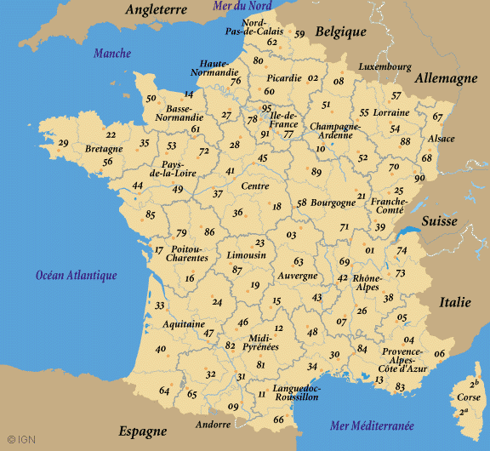
Sludge spread perimeter
13 departments
1007 authorized municipalities
529 agricultural exploitations
163 347 total acres
155 214 acres spreadable

Slide 19
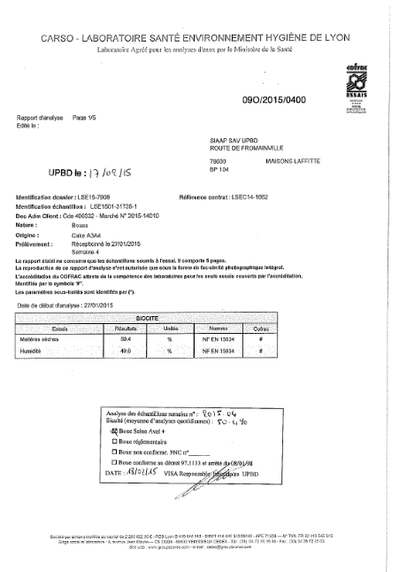
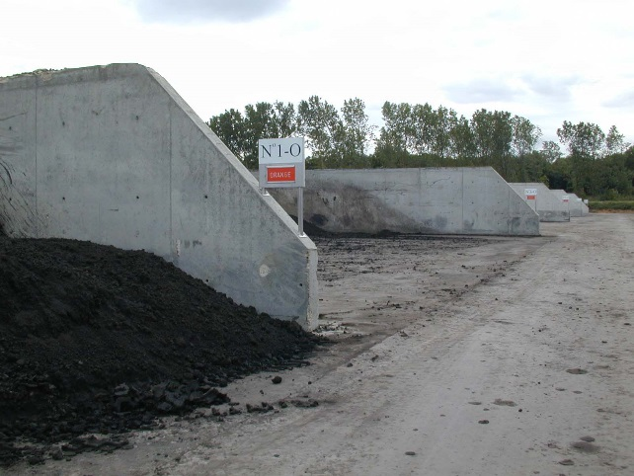
Analytical monitoring of sludge and traceability
1 week of production = 1 VA - ETM - CTO analysis, 52 analyzes per year
1 batch = 1 to 2 weeks of production
Each lot of Seine aval sludge is therefore characterized by at least one complete analysis.
Sampling | Storage | Analysis
Weekly collection of 260 elementary samples as production progresses Constitution of a representative weekly average sample | Analysis of the average sample by a COFRAC accredited laboratory In situ sludge storage awaiting analysis results | Confirmation of conformity of the lot of sludge concerned Choice of the recovery or adapted disposal route
Notes:
During a production week, with each mud pressed a sample is taken and will be a sample representation of the week.
The sludge is stored in well-defined storage cells until the return of the analyzes. No lot of mud is evacuated from the site without having the return of the analyzes.
The conformity of the sludge will make it possible to evacuate them in agricultural valorization (spreading or composting). If the sludge does not comply, it is sent to a non-hazardous waste landfill.

Slide 20
Sludge treatment and valorization paths
 |  | Treatment stage and valorization path | WWTP
On-site treatment | Step 1 | Digestion | SAV, SAM, SEG
 | Step 2 | Dewatering | SAV, SAM, SEC, SEG, MAV, SEM
 |  | Drying | SAM, SEG
 |  | Thermal conditioning | SAV
On-site valorization | Step 3 | Incineration | SAM, SEC, MAV
Off-site valorization |  | Recycling to land | SAV
 |  | Compost | SAV, SAM, SEC, SEG, MAV, SEM
 |  | Off-site digestion | SAM, SEG
 |  | Cement plant | SAM, SEG

Slide 21
SLUDGE
Foccus on resources recovery

Slide 22
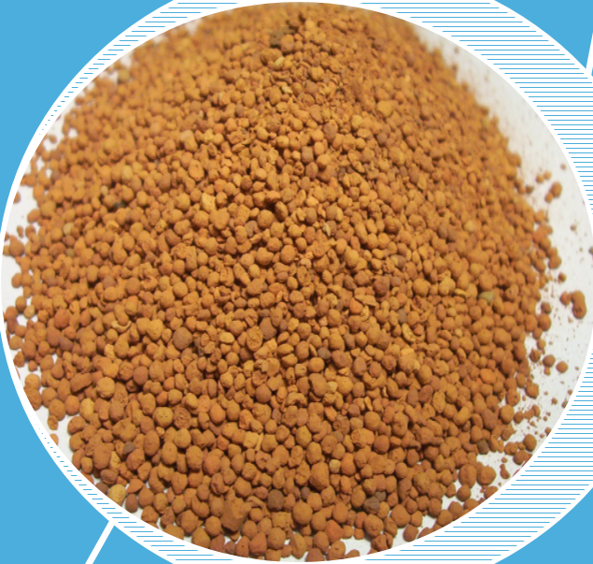
Incineration residues
Ashes (9 000 t/year):
    Environmental characterization
    → Recognized as non dangerous waste
    Valorization paths
    → Landfill rehabilitation (at present)
    Extraction of phosphorus (future)
    Building materials (under study)
Flue gas cleaning residues (1 000 t/year):
  Regeneration
  → Brine & gypsum
  … otherwise : Landfill
Notes:
Bicarbonate de sodium : 2 NaHCO3 + SO2 + ½ O2 Na2SO4 + H20 + 2CO2
Ajout de CaCl + H20 → NaCl CaSO4
On other treatment plants, we incinerate the sludge, which leads to the production of

Slide 23
BIOGAS
Energy recovery prospects

Slide 24
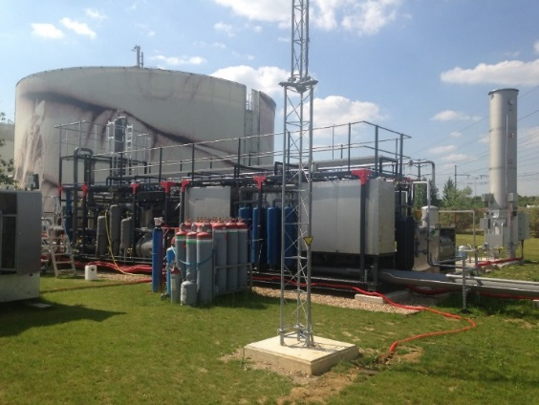
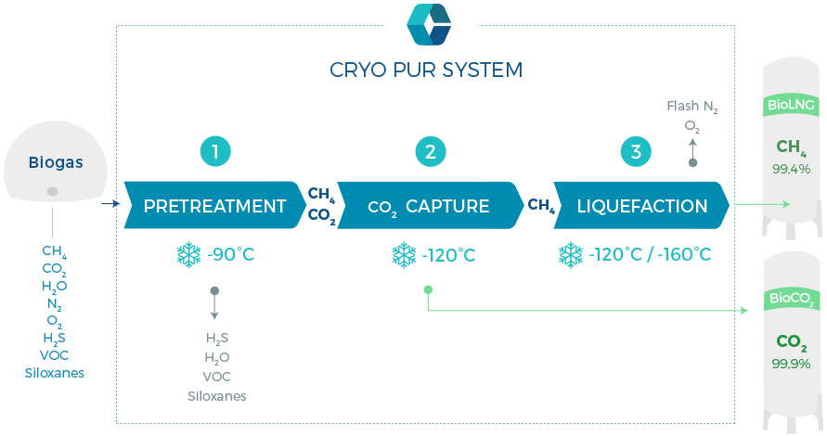
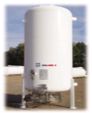
BioGNVAL project
Demonstrator siting on the « Seine Amont » WWTP at Valenton
Integrated biogas upgrading and liquefaction technology
  BioLNG : Bio Liquid Natural Gas
Flow_{(in)} : 120 Nm³/hour of biogas
Production : 1 ton/day of bioLNG
: 1,5 ton/day of bioCO₂
1 m³
of BioLNG
1 000 Nm³
of Biogas
Notes:
Test objectives
Prove the economic relevance of bioLNG (liquefied natural gas) production
Check the cryogenic technology performance
as biogas upgrading solution,
Check the bioLNG (liquefied natural gas) compliance with vehicle fuel
standards and industrial uses…
Check the relevance of bioCO₂ as cooling ,
greenhouse,… uses.

Slide 25
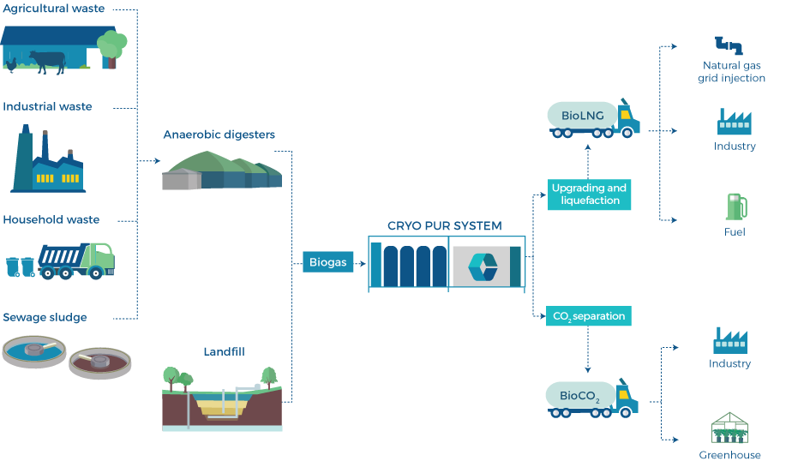
BioLNG and BioCO₂ valorization
Notes:
Here are the different types of possible bioLNG (liquefied natural gas) and carbon dioxide resources recovery as well as the different sources of biogas production
In France, since 2011, biogas can be injected in the natural gas network, after a specifical treatment.
Wastewater Treatment Plant will be the bioenergy factory of the future

Slide 26
Biogas valorization paths
Biogas
Site of production
« Light » treatment
Purification : Biomethane
Pipes
Heat
Cogeneration
(Heat + Electricity))
Compression
Odorization
Control
Liquefaction
Plant
needs
Existing
Bio – NGV
200 bars
Industry
Heat network
Electricity
Network
Under study
Demonstrator
Gas network
4 to 16 bars
BioLNG
- 160°C
Notes:
Natural gas for vehicle
In France, since 2011, biogas can be injected in the natural gas network, after a specifical treatment.
WWTP will be the bioenergy factory of the future

Slide 27


BioLNG : Energetic Density Value
Volumes divided by 1 000
1 000 Nm³
of Biogas
1 m³
of BioLNG
0,6 m³
of Diesel
Transport and Storage volume reduction
The energy density is close to the diesel’s
Notes:
27

Slide 28
BioLNG analysis
 | Units | Biogas | BioLNG | NGV standard
CH₄ | % vol. | 61 | 98,6 | 83 min.
CO₂ | % vol. | 38,7 | 0,45 | 14 max.
O₂ | ppm v/v | 261 | 150 | N/A
N₂ | % vol. | 0,33 | 0,95 | 14 max.
H₂ | ppm v/v | 79 | 148 | 5 000 max.
H₂S | ppm v/v | 5,5 | <DL | 10 max
Volatile organic residue | mg/Nm³ | 4,8 | <DL | N/A
Siloxanes | µg/Nm³ | 7 035 | 494 | 5 000 max.
Water | mg/Nm³ | N/A | <DL | 55 max.
NMHC | % vol. | N/A | <DL | 13 max.
Methane number | Kubesh | N/A | 100 | 70 min.
Standards for vehicle fuel

Slide 29
Seine aval treatment plant actual energy balance
Non Renewable Energy
Green Energy
Purchased
Energy
145 GWh
7500 tCO₂e
Process
Heat
Electricity
105 GWh
25 000 tCO₂e
90 GWh
4500 tCO₂e
Heat
60 GWh
14500 tCO₂
Biogas
Reduced emission
Direct emission
7500 tCO2e
42 000 tCO₂e
313 GWh
Gas turbine
Energy Self-sufficence : 69 %
Notes:
Currently, we use the energy produced by sludge in the form of biogas to supply our customers with energy from the site in direct form with gas, but also electricity through gas turbines.
Thus, it allows us to reduce our carbon dioxide emissions.

Slide 30
Seine aval treatment plant future energy balance
Non Renewable Energy
Green Energy
Purchased
Energy
274 GWh
14 000 tCO₂e
Process
Heat – Sludge incineration
105 GWh
25 000 tCO₂e
Heat
60 GWh
14500 tCO₂
Biogas
Reduced emission
Direct emission
14 000 tCO2e
42 000 tCO₂e
Public Gas Grid
345 GWh
Avoided emission
92 000 tCO₂e
Energy Self-sufficence : 38 %
Notes:
The desired evolution would be to increase the production of Biogas and to reinject it into the network.
At first the direct production of carbon dioxide would increase, but ultimately reduce overall.

Slide 31
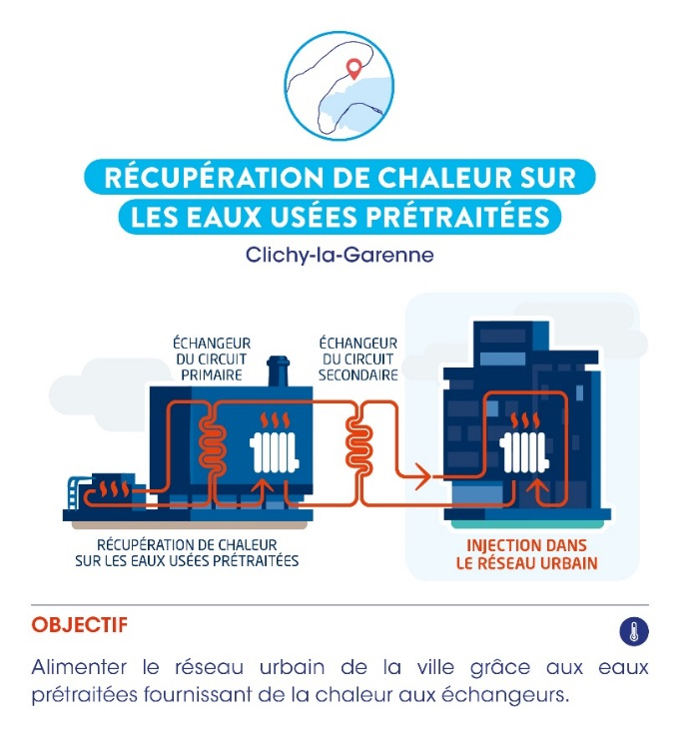
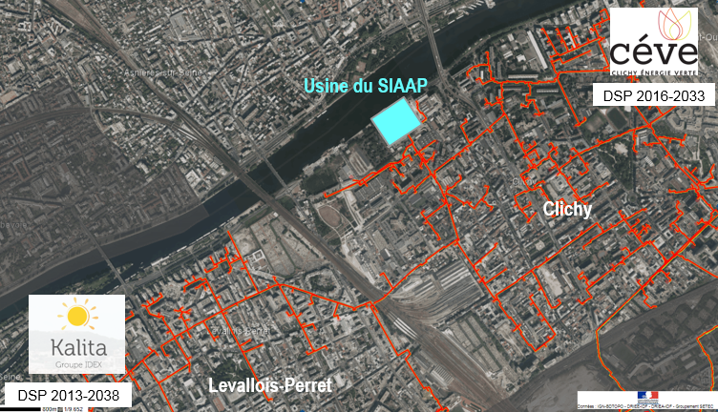
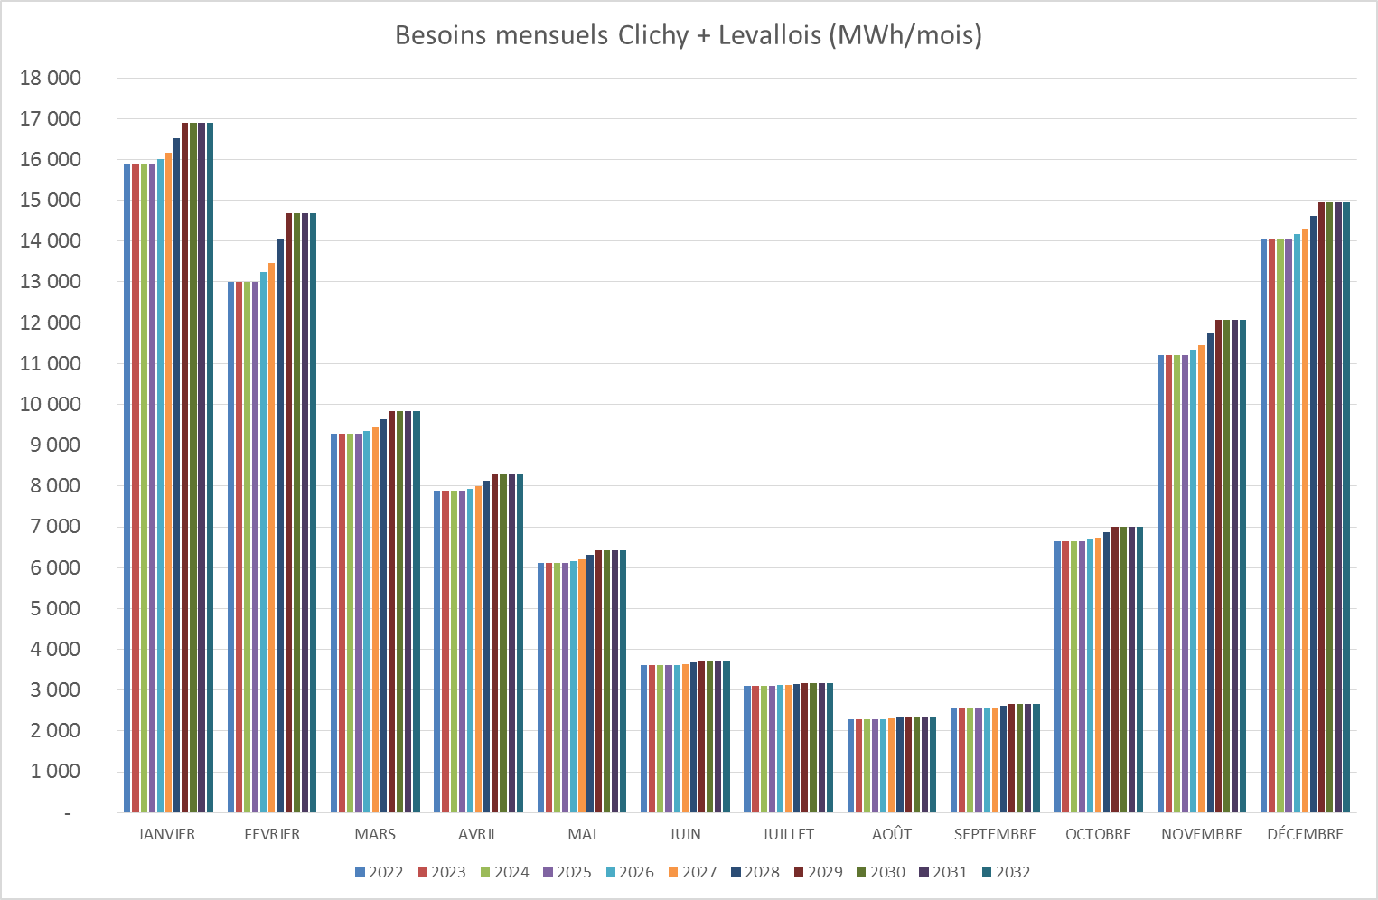
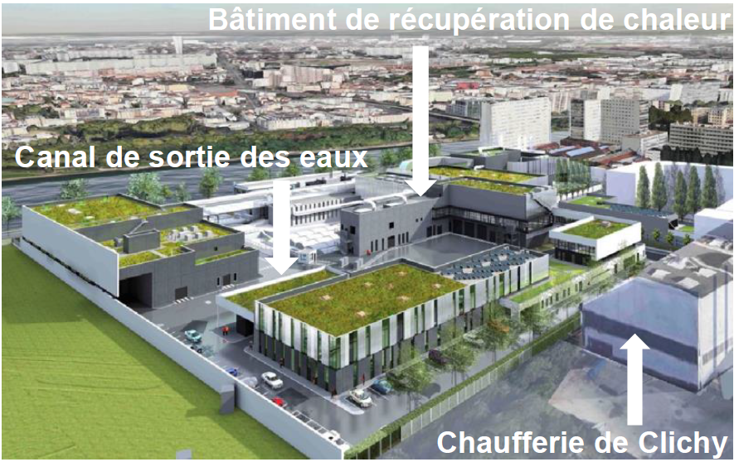


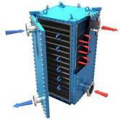
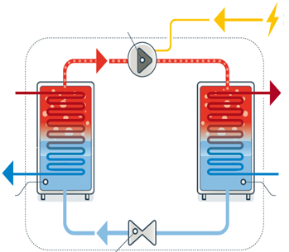
Heat recovery projects
Clichy : Wastewater networks waste heat recovery
63 000 MWh/year
10 000 housings
Start-up
on 2022
Clichy Plant
Wastewater field
Primary circuit
Secondary circuit
Heating network
Plated heat exchanger
Heat pump
Notes:
At our Clichy site, we have a project for heat recovery at the effluent level. This would supply energy to a district heating network

Slide 32
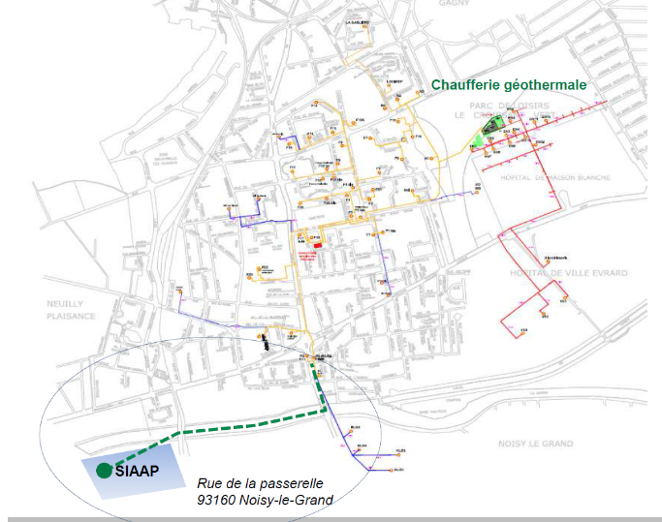
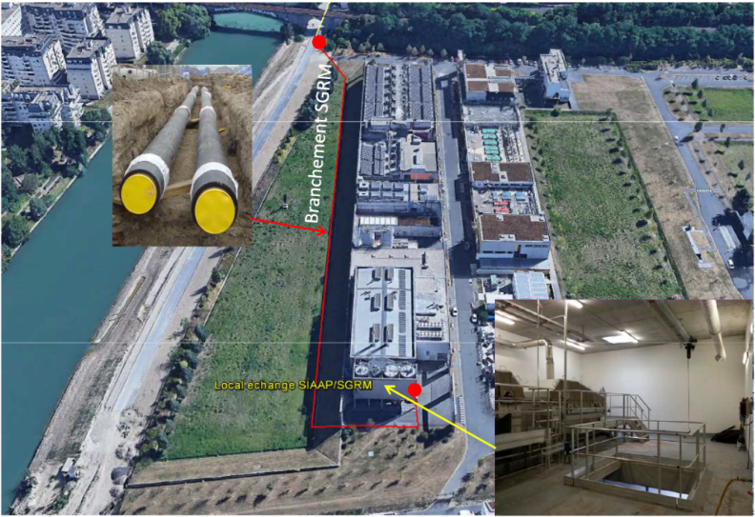
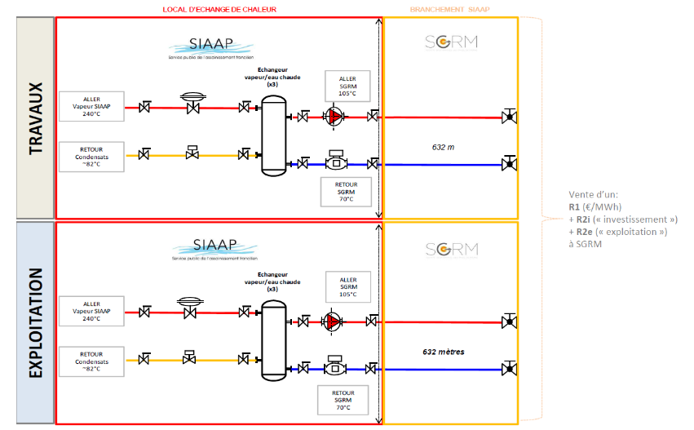
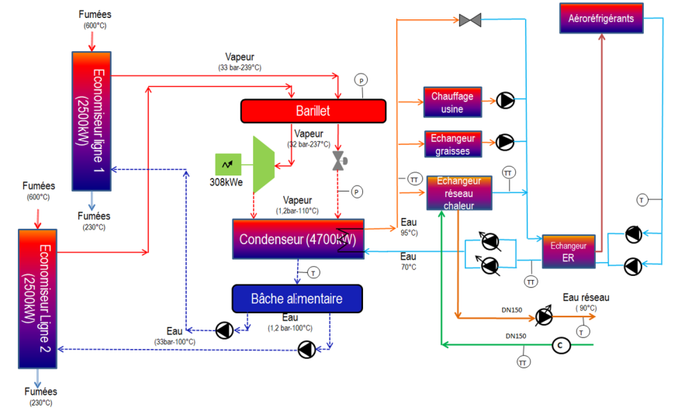
Heat recovery projects
Marne Aval : Incinerator networks waste heat recovery
Neuilly sur Marne heat network
Partner : IDEX SGRM
Potential : 5 500 MWh/y
Notes:
On our MAV station, we have a project of study of heat recovery at the level of the incineration network

Slide 33
SLUDGE
Resources recovery prospects
Notes:
The Seine river : a key feature of Paris landscape
And the SIAAP is in charche to protect and improve its quality

Slide 34

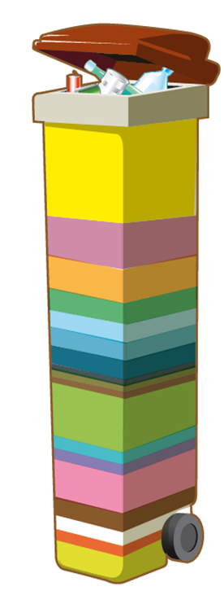
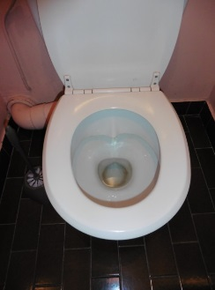
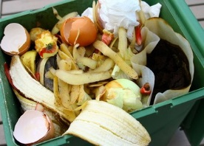
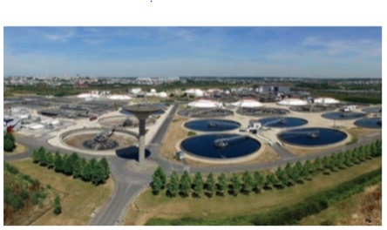



Co-digestion project
Innovation Partnership for combined digestion of organic maters
50 kg/y
355 kg/y
500 kg/y
75 kg/y
Organic fraction from household waste
Sewage sludge
Co-digestion
Dedicated digestion
Digestate
Digestate
Energy
Energy
Land
Biogas
Notes:
With the agency which is in charge of waste treatment in the parisian region, the SYCTOM, the objective is to produce more biogas from all organic fields

Slide 35
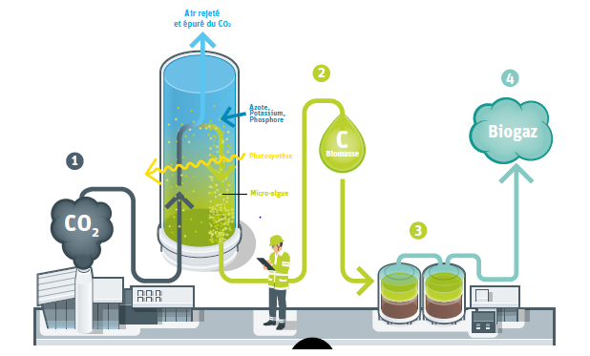
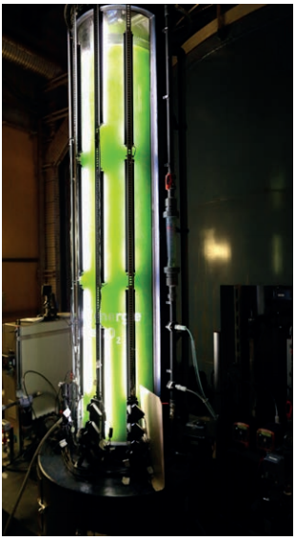
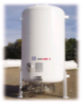
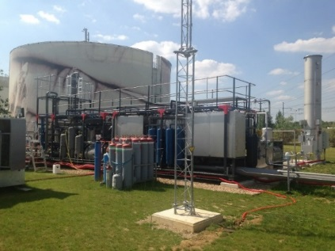
Other innovative projects
Other innovative projects
Carbon sink : CO₂ capture in incineration flue gas with microalgae : Demonstrator siting on the « Seine centre » WWTP
Integrated biogas upgrading and liquefaction technology : Demonstrator siting on the « Seine Amont » WWTP
1 m³
of BioLNG
1 000 Nm³
of Biogas
  BioLNG : Bio Liquid Natural Gas
Flow_{(in)} : 120 Nm³/hour of biogas => Production : 1 ton/day of bioLNG + 1,5 ton/day of bioCO₂
Notes:
We are also working on two other projects:

Slide 36
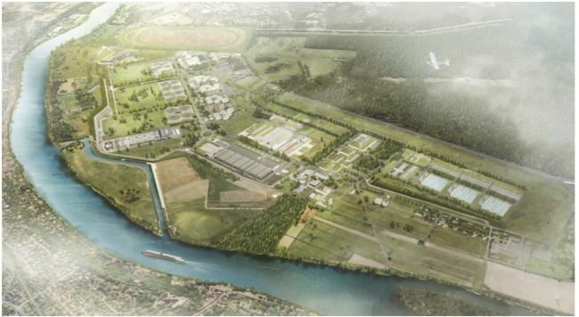


Thanks for your attention

